Slide 1
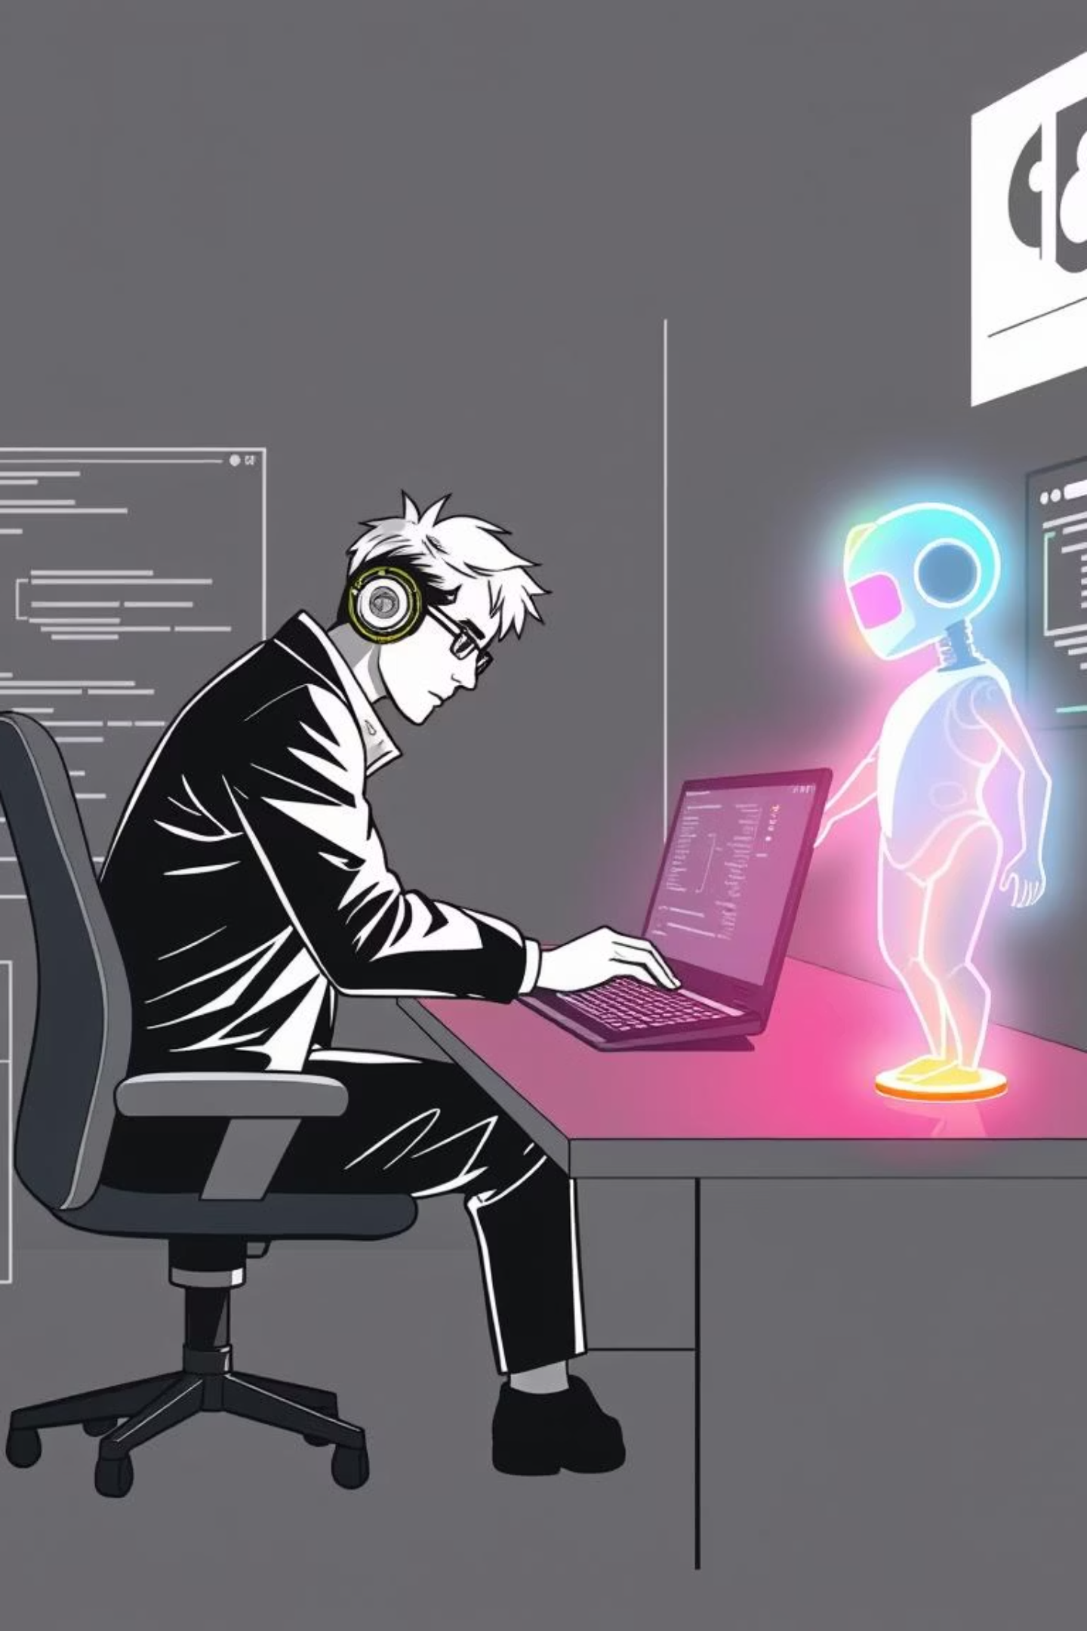
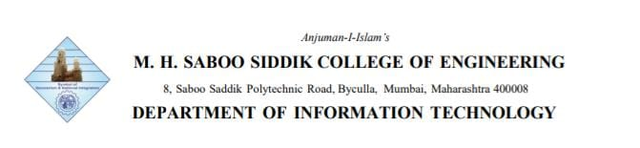
Vibe Coding: The New Code Culture
Explore how Artificial Intelligence, enhanced collaboration, and a focus on "goon vibes" are reshaping software development.
Team Members
232453 Ariz Shaikh
232460 Yusuf Aslam
242464 Yamin Khan
242466 Abdurrahman Qureshi
242469 Rumaan Shaikh
242471 Sameer Shaikh

Slide 2

What Is Vibe Coding?
Vibe Coding represents a significant cultural shift in software development, moving towards a paradigm where AI actively generates code based on natural language prompts. It's an evolution from "vibe coding," a term coined by Andrej Karpathy, embracing AI not just as a tool, but as a creative coding partner. This approach prioritizes intuitive flow and rapid iteration over meticulous syntax mastery.
1
AI as a Creative Partner
Leveraging advanced AI models to generate initial code drafts and explore creative solutions.
2
Focus on Intuition
Developers guide AI with high-level descriptions, allowing for a more fluid and less syntax-bound process.

Slide 3



Defining the Vibe: A New Workflow
Prompt Generation
Developers articulate desired features in natural language, setting
the initial "vibe."
AI Code Synthesis
AI models interpret prompts to generate functional code snippets or
full modules.
Human Refinement
Developers review, debug, and iteratively refine AI-generated code, guiding it towards perfection.
Continuous Iteration
The cycle repeats, allowing for rapid evolution and creative exploration of software solutions.

Slide 4
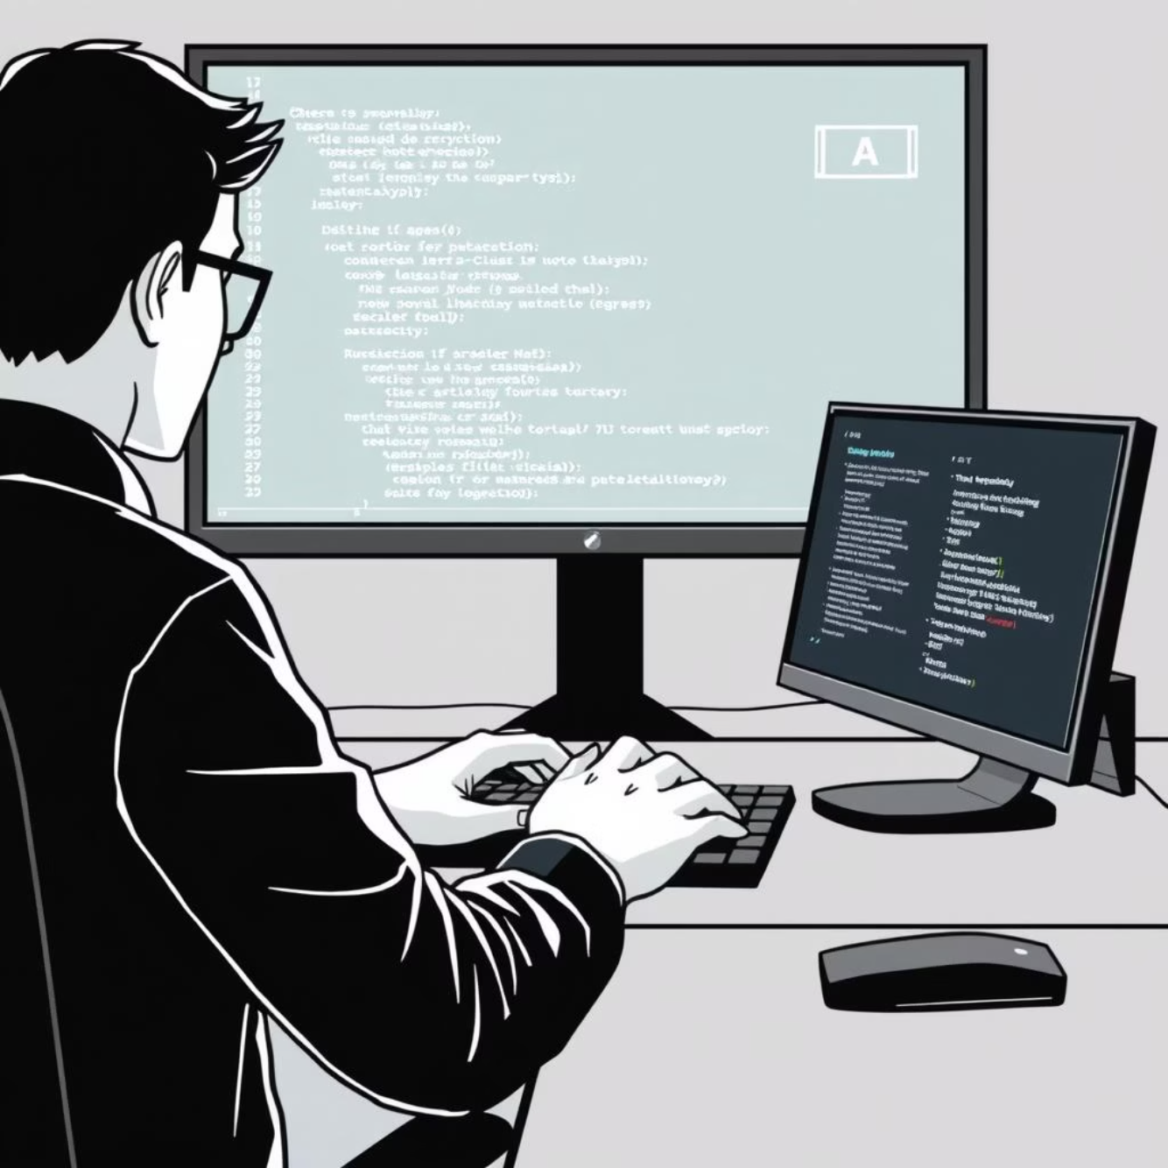
How Vibe Coding Works: The Process
Natural Language Input
1
Developers describe requirements, high-level logic, or specific tasks using everyday language.
2
AI Code Generation
AI interprets the prompt, understanding context and intent to produce initial code drafts.
Iterative Refinement
3
Human developers review AI output, providing natural language feedback for corrections and improvements.
4
Debugging & Validation
Human expertise ensures the generated code is functional, secure, and aligns with project goals.

Slide 5



AI as an Integral Team Member
Vibe Gooning extends beyond individual coding to transform team dynamics, giving rise to "vibe teaming." In this collaborative environment, AI isn't just a tool, but an integrated team member, actively supporting ideation, drafting, and synthesis across the entire development lifecycle. This strategic integration significantly reduces menial, repetitive tasks.
Ideation Partner
Drafting Assistant
Synthesis & Integration
AI assists in brainstorming, generating diverse approaches to complex problems.
Automates the creation of initial code, documentation, and test cases.
Helps connect disparate components and ensure architectural consistency.
By offloading the mundane, human developers are freed to focus on higher-level strategic planning, complex architectural design, and creative problem-solving, fostering a more engaging and impactful role for the human element in software creation.

Slide 6

Advantages of Vibe Coding: Accelerating Innovation
10x
Hours
New Users
Development Speed
Time to Prototype
Coding Democratized
Accelerates prototyping and feature implementation by generating code rapidly.
Reduces the time from concept to functional prototype from weeks to hours.
Empowers non-engineers to build basic applications using natural language descriptions.

Slide 7
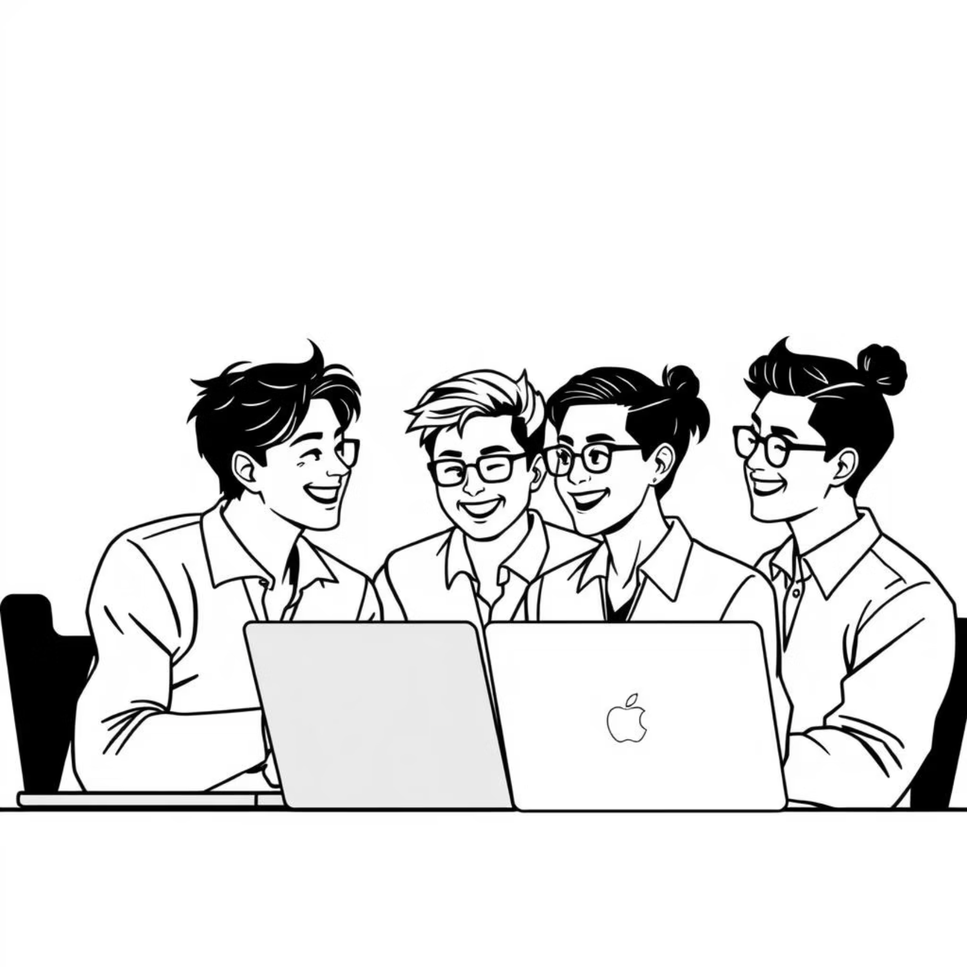
More Benefits: Empowering Teams & Individuals
Beyond speed and accessibility, vibe gooning cultivates a more enriching and productive environment for development teams.
It significantly enhances team collaboration by offloading repetitive and tedious tasks to AI, allowing human members to focus on more complex, creative, and strategically valuable work.
Boosted Collaboration
AI handles routine tasks, allowing teams to collaborate on high-value initiatives.
Enhanced Creativity
Developers can maintain optimal "flow states," dedicating mental energy to innovative solutions.
Higher Job Satisfaction
Focusing on creative work and problem-solving leads to greater fulfillment.

Slide 8
Disadvantages & Risks: The Shadow Side of AI Coding
While vibe gooning offers transformative benefits, it also introduces a new set of challenges and risks that require careful consideration. One significant concern revolves around code maintainability. Developers may not fully grasp the intricacies of AI-generated code, leading to difficulties in future debugging, modifications, or integration with existing systems. This can result in "black box" code that is hard to manage.
Reduced Code Comprehension
Subtle Bugs & Flaws
Developers might struggle to understand complex AI-generated code, impeding future maintenance and updates.
AI-generated code, though functional, can harbor subtle logical errors or security vulnerabilities that are hard to detect.

Slide 9
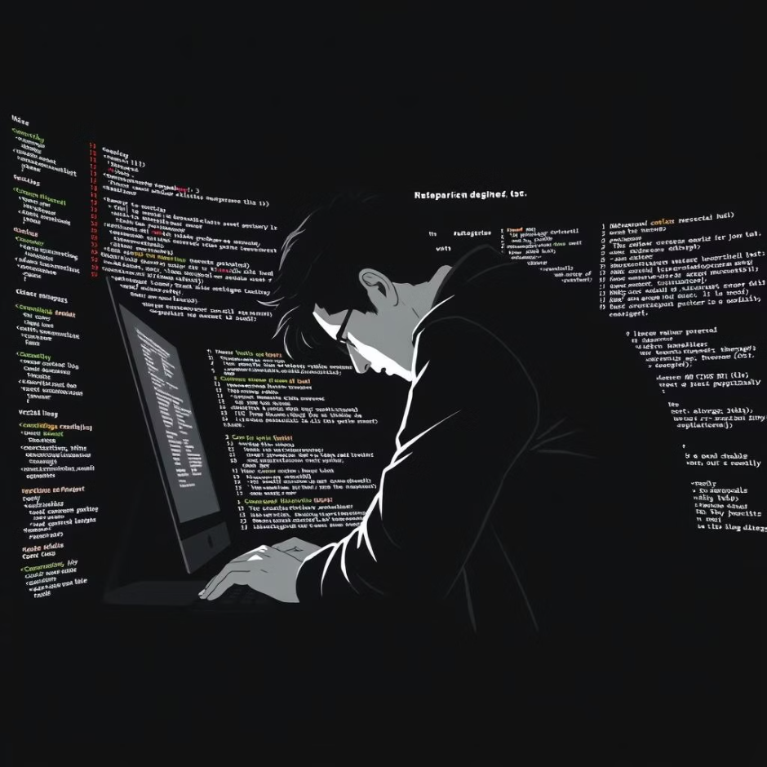

Challenges in Practice: Balancing Innovation with Caution
Implementing vibe gooning successfully in real-world scenarios presents practical challenges. A primary concern is the potential for overreliance on AI to erode fundamental technical skills among human developers.
Erosion of Deep Skills
Constant AI assistance may lead to a decline in foundational coding and problem-solving abilities.
Caution in High-Stakes
Industries like banking or healthcare remain wary due to the high cost of errors in critical systems.

Slide 10
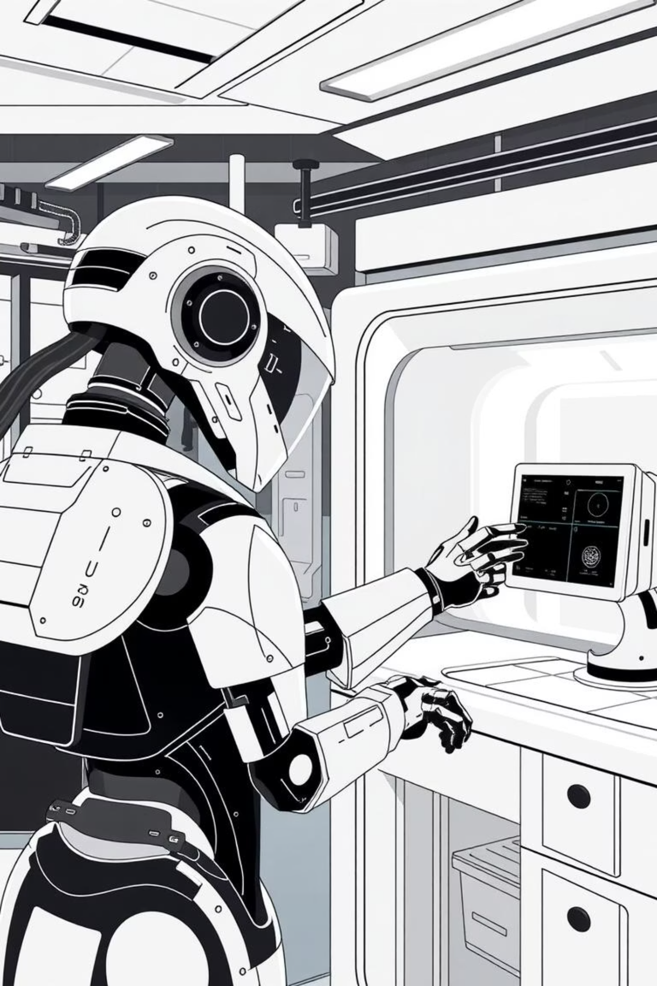



Testing in Vibe Coding: An Evolving Landscape
The rise of vibe gooning fundamentally redefines the role and methodologies of software testing. Instead of relying heavily on manual code review, the focus shifts towards sophisticated AI-assisted debugging and automated test generation. This paradigm requires robust continuous integration and continuous deployment (CI/CD) pipelines.
AI-Assisted Debugging
AI models actively analyze generated code, identifying potential errors and suggesting fixes.
Automated Test Generation
AI creates comprehensive unit, integration, and end-to-end tests based on requirements.
Integrated CI/CD Pipelines
Continuous integration pipelines incorporate AI-powered tools to catch and rectify errors early in the development cycle, ensuring high-quality software delivery.

Slide 11
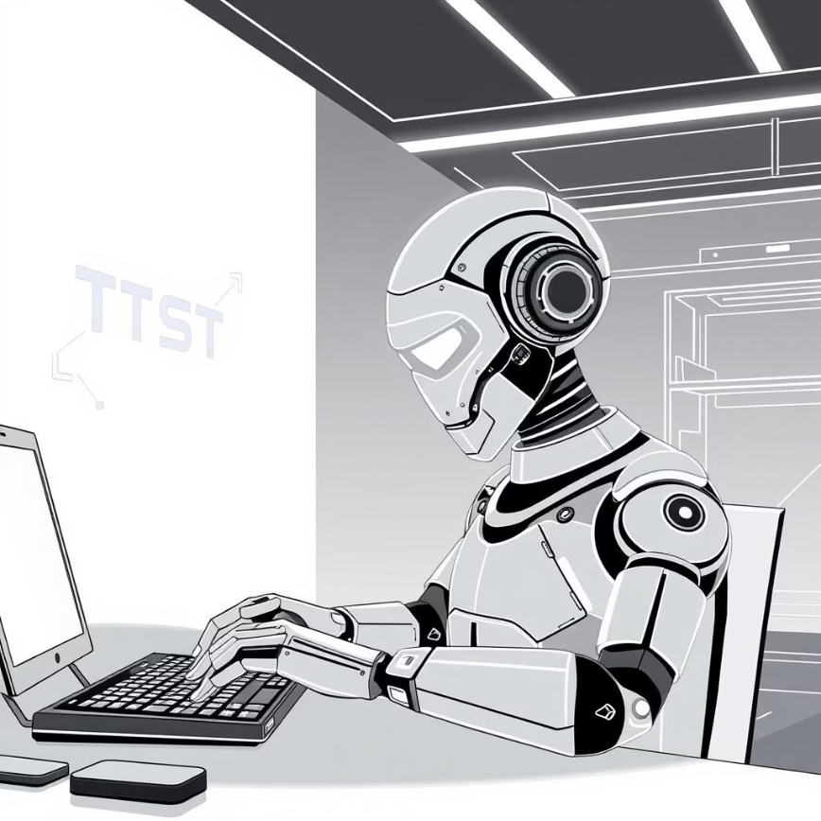
Testing in Vibe Gooning
Vibe coding fundamentally shifts testing from laborious manual debugging to highly efficient, AI-assisted verification. Developers now harness AI to instantly generate comprehensive test cases and rapidly pinpoint errors, significantly accelerating the entire quality assurance process.
Example: At Zafin, implementing iterative vibe coding cycles, powered by AI, led to an impressive 40% reduction in UI bug fixes, demonstrating its tangible impact on development speed and reliability.

Slide 12

Testing Challenges & Best Practices
Subtle Bugs & Human Oversight
Prompt Refinement & Feedback Loops
While AI excels at speed, its generated code can sometimes introduce subtle, hard-to-detect bugs. Therefore, human oversight and critical review remain absolutely essential.
Effective testing within vibe gooning relies on continuous prompt refinement and robust AI-human feedback loops to ensure generated tests align with complex requirements.
Trust But Verify
Embracing a "trust but verify" mindset is crucial. This balances the unparalleled speed of AI with the necessary rigor for maintainability and long-term code health.

Slide 13
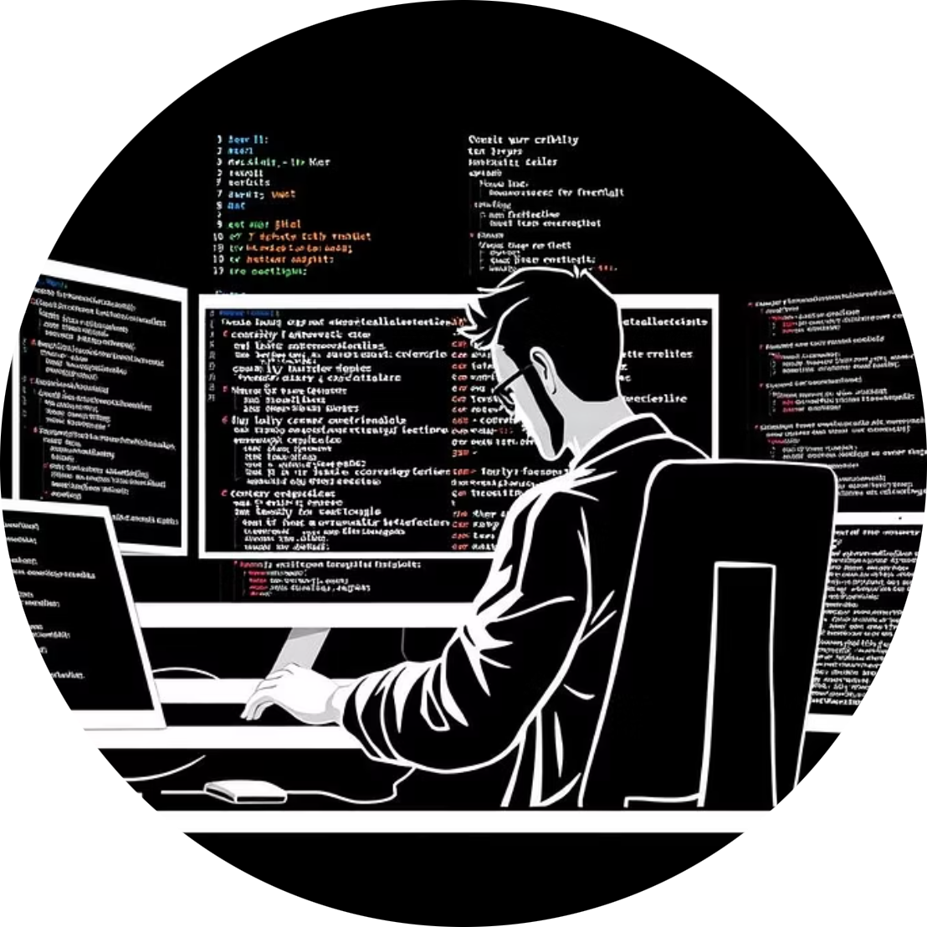
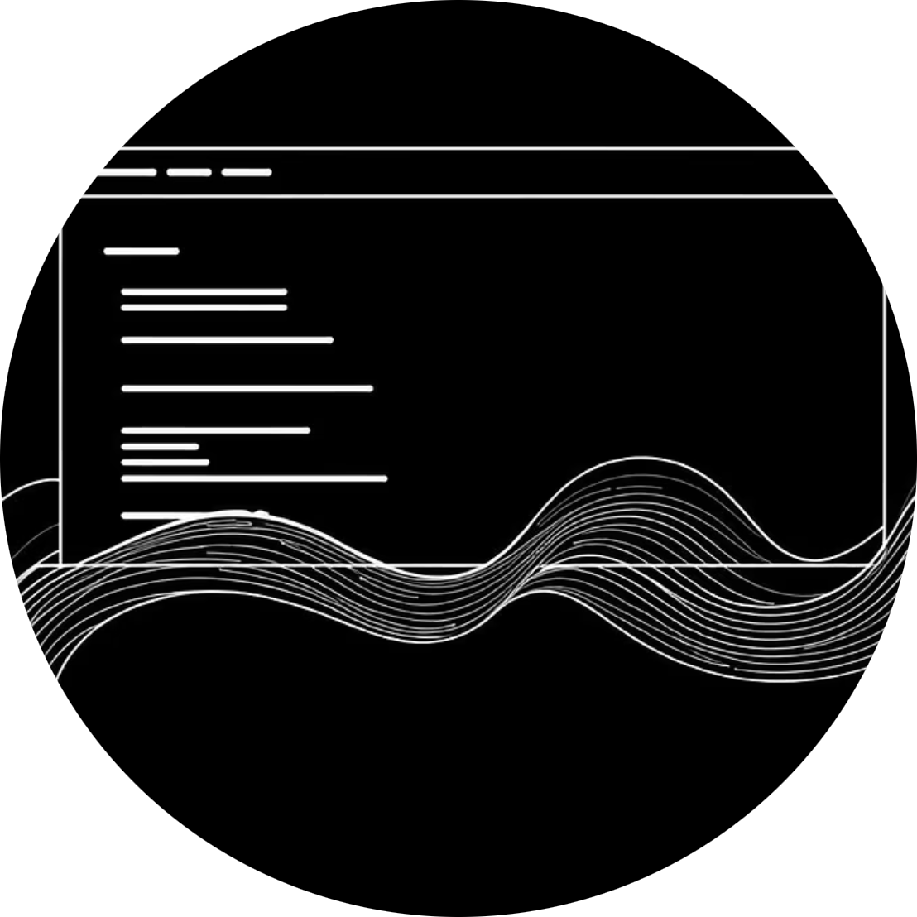
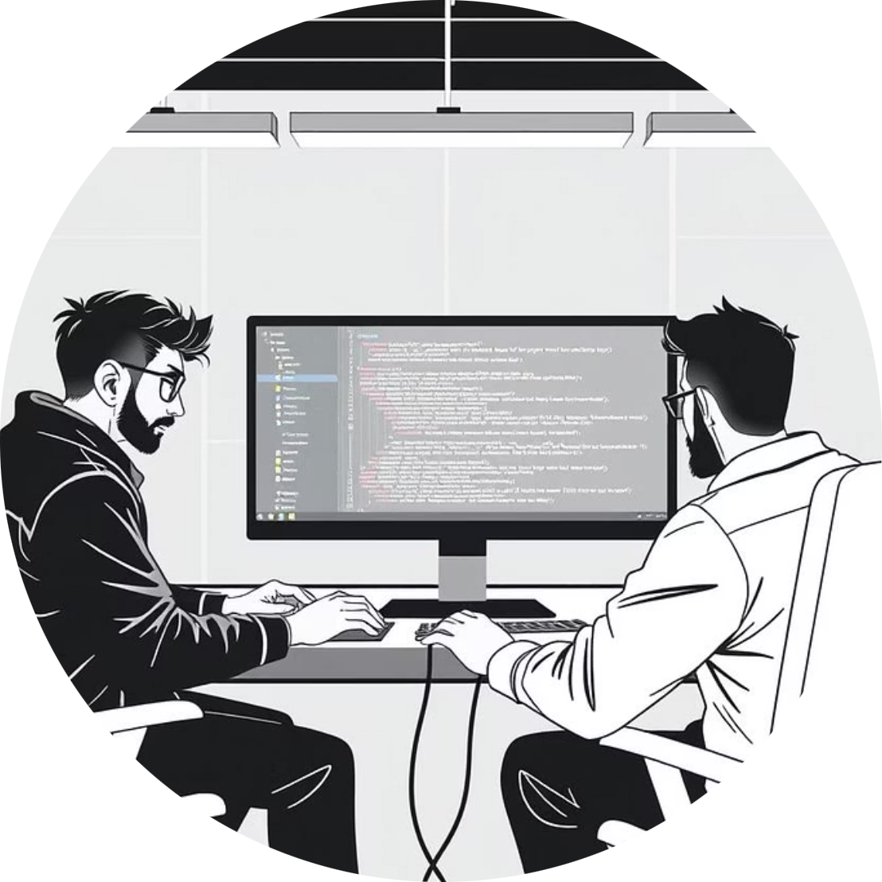
Alternatives to Vibe Gooning
Traditional Coding Rigor
Low-Code/No-Code
Hybrid Collaboration
Conventional coding methodologies still prevail in high-stakes sectors like banking, where risk sensitivity and stringent regulations demand meticulous, human-driven development.
Platforms like Bubble or Webflow offer another path to democratization, simplifying development for non-programmers, yet often lack the creative flexibility and deep customization of vibe coding.
Hybrid models, combining AI-driven vibe coding with traditional pair programming, offer a balanced approach, merging rapid innovation with robust human control and oversight.

Slide 14
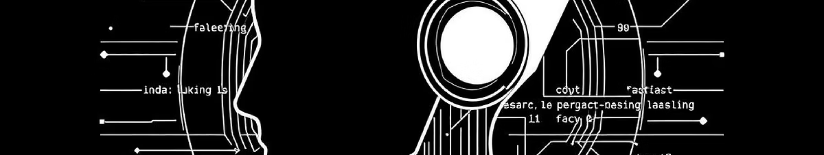
Emerging Tools & Approaches
The landscape of coding is evolving rapidly with powerful AI integration.
AI Agents: Claude & Cursor
Deep AI Integration: Notion
Autonomous AI Agents
Advanced AI agents like Claude and Cursor are at the forefront, powering vibe coding with natural language processing for intuitive, high-quality code generation.
Companies like Notion are integrating AI deeply into their development workflows, with an impressive 30-40% of their codebase now AI-assisted, showcasing mainstream adoption.
Future alternatives may include sophisticated AI "agents" autonomously managing complex background tasks, liberating developers for purely strategic and creative endeavors.

Slide 15

Summary — The Vibe Gooning Revolution
01
02
Creative Orchestrators
Accelerated Innovation
Vibe gooning transforms developers into creative orchestrators, shifting focus from tedious syntax to high-level strategy and innovative problem-solving.
The synergy of AI-human collaboration dramatically accelerates prototyping, democratizes software creation, and amplifies collective knowledge within teams.
03
Culture of Flow & Trust
This new culture embraces deep flow states, fosters trust in AI as a capable partner, and champions rapid iteration to constantly push the boundaries of innovation.

Slide 16
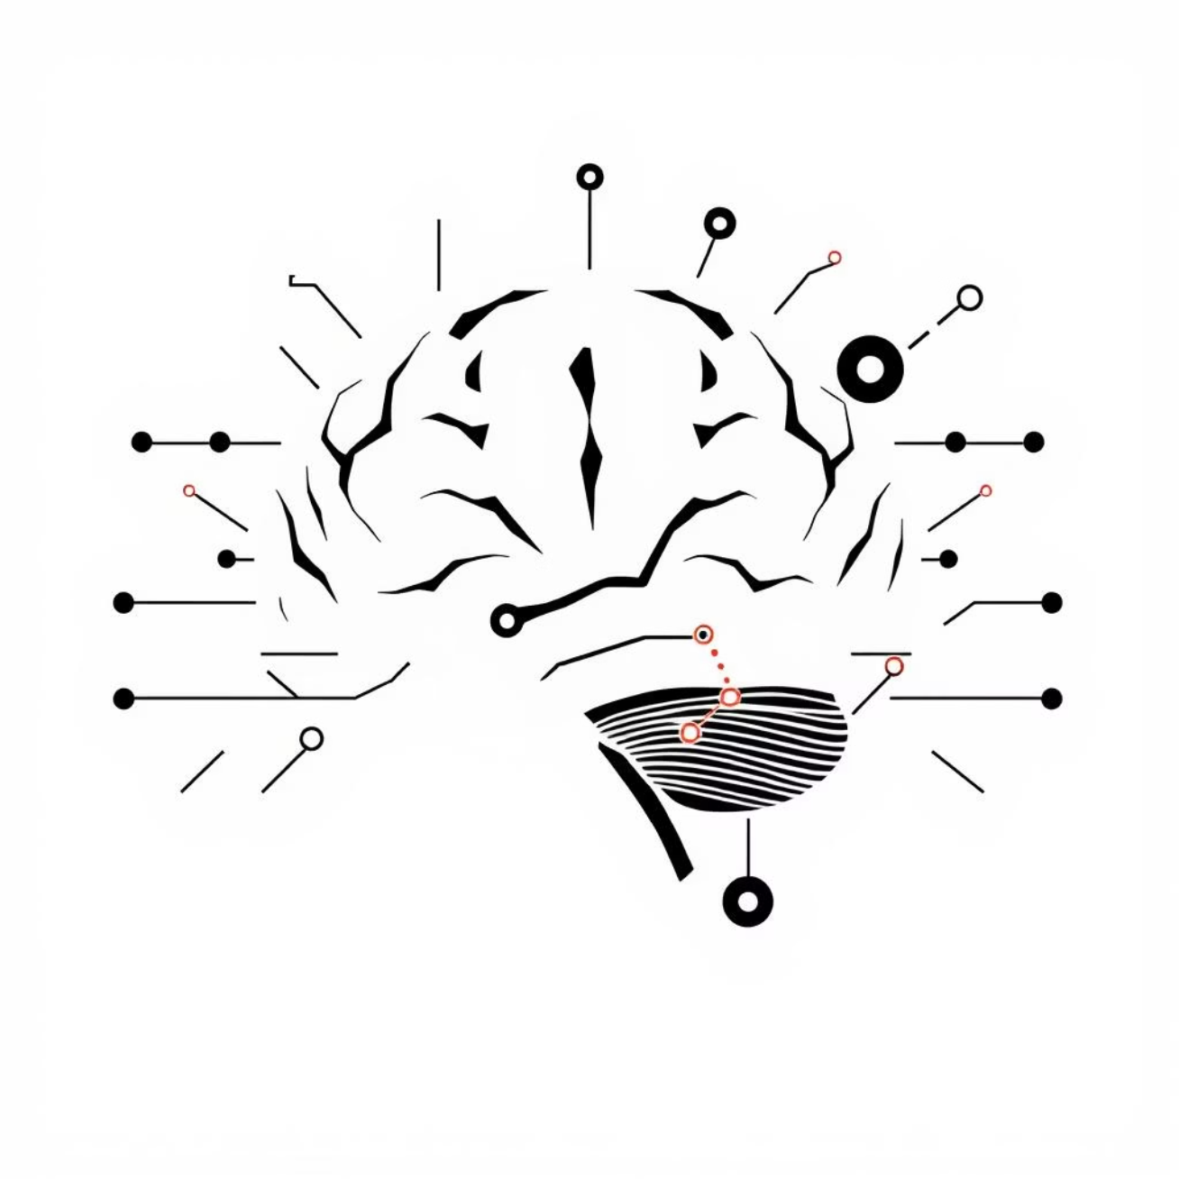
Miscellaneous Insights & Future Outlook
Origins & Mainstream Adoption
The term "vibe coding" was coined by Andrej Karpathy, now a recognized paradigm reshaping modern software development.
Lingering Challenges
Despite its benefits, challenges persist, including managing code maintainability, ensuring deep code understanding, and navigating ethical AI use.
Future: "Vibe Teaming"
The future points towards even deeper AI integration within teams, evolving into "vibe teaming" to enhance collective intelligence and output.

Slide 17
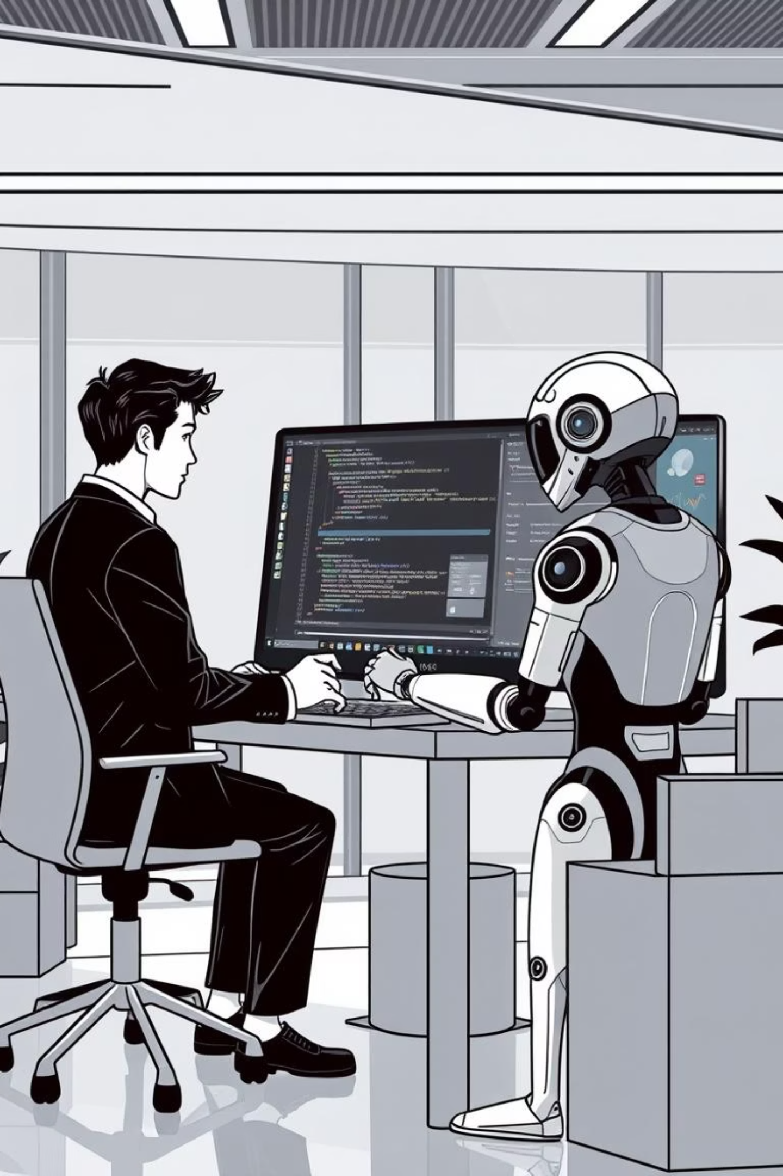
From
Typist
to Orchestrator

Slide 18
Optimizing Creativity & Focus

Slide 19
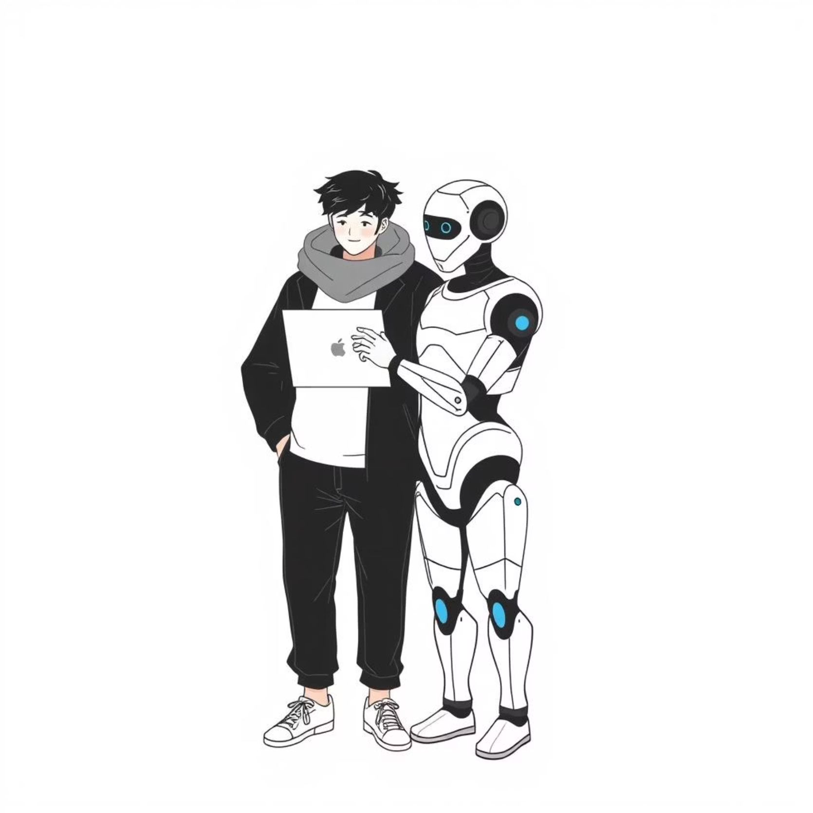

The New Era of Coding is Here
Embrace AI as a creative partner, not just a tool.
Leverage its capabilities to augment your ideas and accelerate your development process.
Collaborate, vibe, and innovate faster than ever before.
Foster a culture of shared understanding and rapid iteration with your AI companions.
The future belongs to those who vibe goon with AI.
Adapt and thrive in this evolving landscape where human ingenuity meets artificial intelligence.

